Slide 1
CS492 - Operating Systems Memory Management
Georgios Portokalidis & Jun Xu
ZyBook 6.1-6.2, MOS 3.1-3.2
Slides credit: Antonio Barbalace

Slide 2
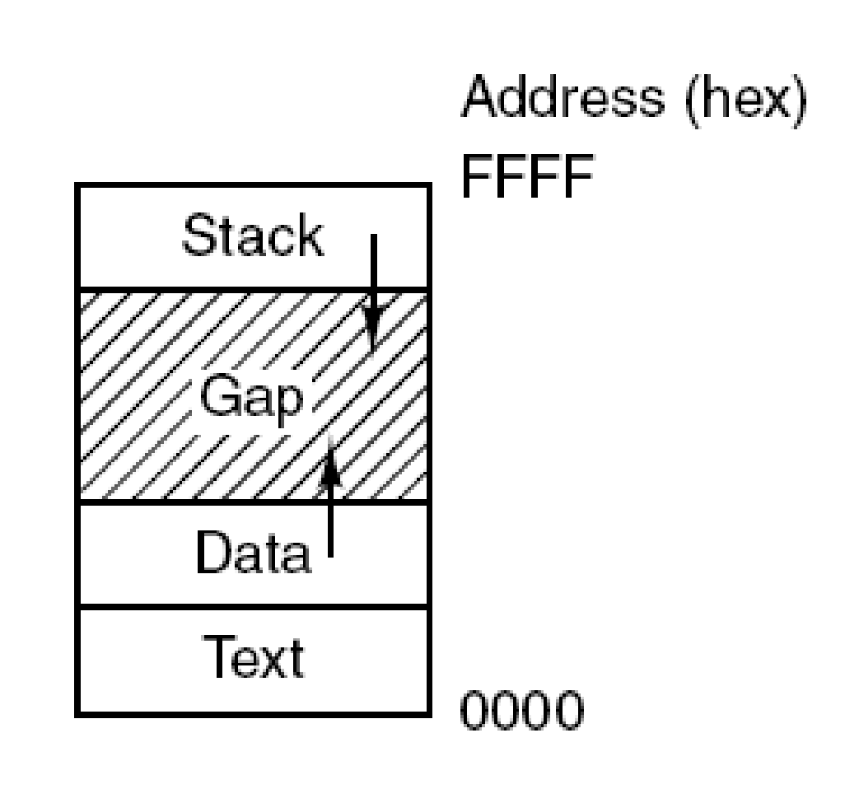
Recap: Processes
Each process has its own exclusive address space
The content of a specific memory address is different in two different processes
The operating system has its own exclusive address space

Slide 3
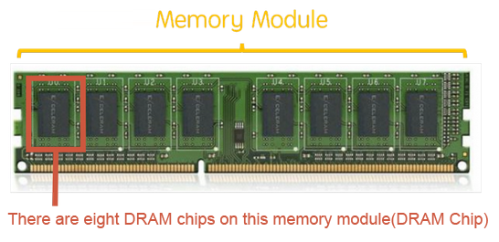
...But Physical Memory
Physical memory (RAM) is a hardware array consisting of words
Word → fixed-size unit of data (typically 2 bytes)

Slide 4
...But Physical Memory
Physical memory (RAM) is a hardware array consisting of words
Word → fixed-size unit of data (typically 2 bytes)
Array grows based on available hardware

Slide 5
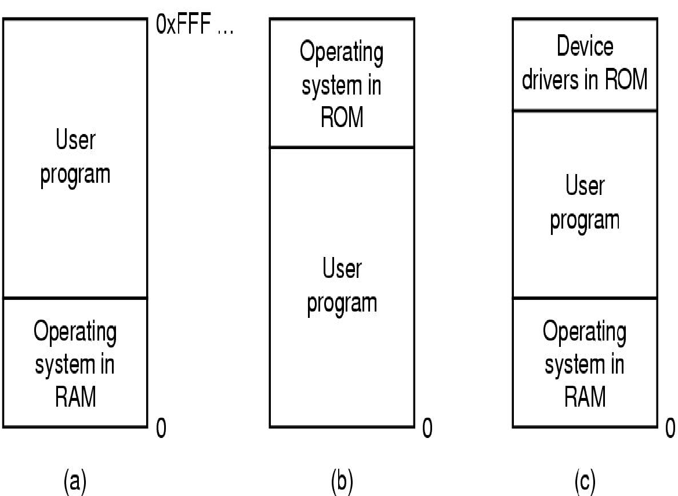
One Program with No Memory Abstraction
The program lives and works directly on physical memory
Total RAM
Shares physical memory with the OS
No isolation → The program can tamper with OS code and data
OS as a library
Example, MSDOS
Total RAM
0x0000
0x0000
Two simple ways of organizing memory with an operating system and one user process. (MOS Figure 3-1.)

Slide 6

Let’s Start at the Beginning

Slide 7
Multiple Programs with No Memory Abstraction
Every program operates on physical memory
No isolation → Can access each other’s memory
Potentially the OS’s too
Total # of programs depends on their size and memory size
Total RAM
User program
Total RAM
User program
User program
User program
User program
0x0000
User program
0x0000
Two simple ways of organizing memory with an operating system and multiple user processes.
Notes:
Also in this case the OS acts as a library, however it has to manage multiple applications

Slide 8
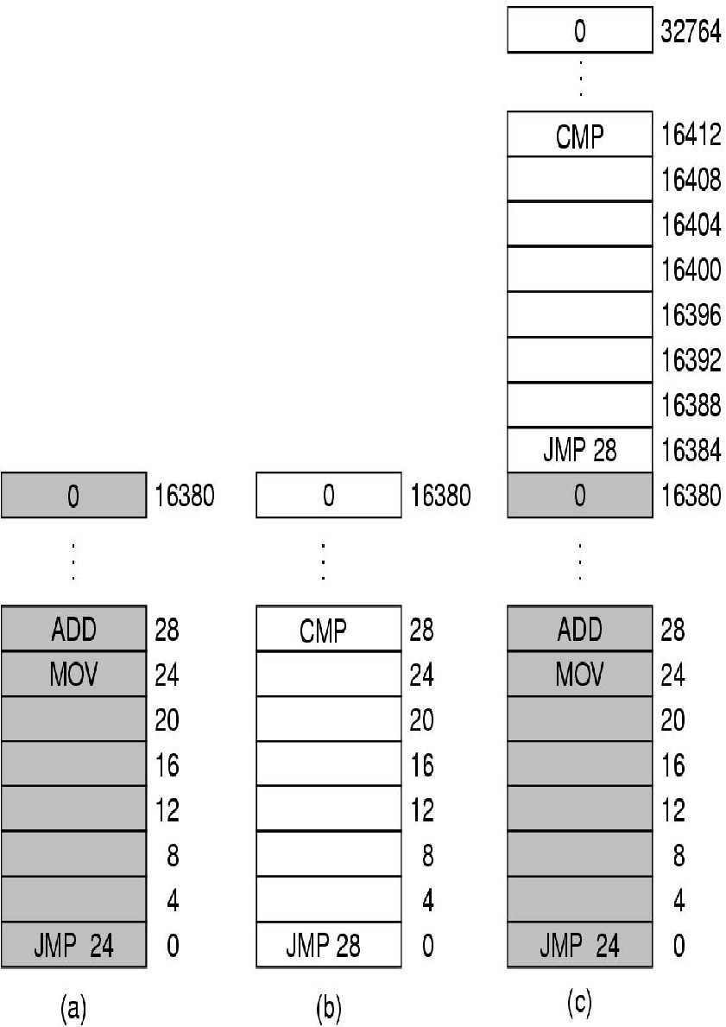
Multiple Programs with No Memory Abstraction
Total ram
Operating system
User program
User program
0

Slide 9



Multiple Programs: Relocation Problem
Illustration of the relocation problem. (a) A 16-KB program. (b) Another 16-KB program. (c) The two programs loaded consecutively into memory. (MOS Figure 3-2.)

Slide 10
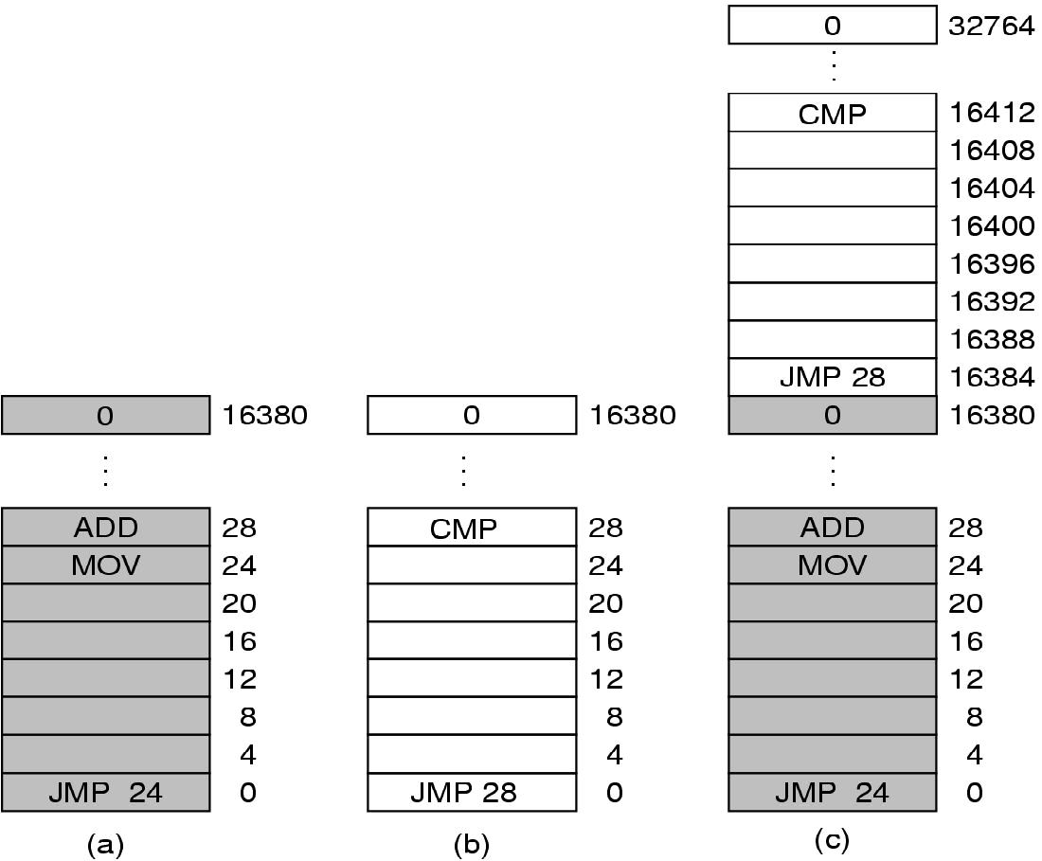
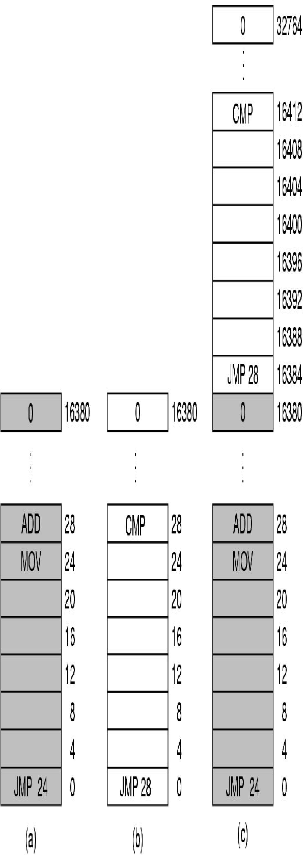
Multiple Programs: Relocation
Programs must be relocatable
Written to be placed and run at any memory address
Extra information in executable
Loader decides where to place them
Based on the available physical memory
It does relocation (increases load time)
16384
JMP 16412
Physical Memory
(before relocation)
Physical Memory
(after relocation)
Notes:
PROBLEM: it requires long time to load, it requires extra information in all executable to indicate how to do relocation (what is an address what a constant)
One application can write on the other, you can only put a finite numbers of applications

Slide 11
Multiple Programs on Physical Memory
All physical memory exposed to processes
User processes may interfere with OS and each other
Processes may access OS’s and each other secrets
Programs must be relocated when loaded
Problems
No protection
Expensive relocation
Update all (absolute) addresses in program (both code and date addresses)
Notes:
The concept of an address space is very general and occurs in many contexts.
Consider telephone numbers. In the United States and many other countries, a
local telephone number is usually a 7-digit number. The address space for telephone
numbers thus runs from 0,000,000 to 9,999,999, although some numbers,
such as those beginning with 000 are not used. With the growth of smartphones,
modems, and fax machines, this space is becoming too small, in which case more
digits have to be used. The address space for I/O ports on the x86 runs from 0 to
16383. IPv4 addresses are 32-bit numbers, so their address space runs from 0 to
232 − 1 (again, with some reserved numbers).
Somewhat harder is how to give each program its own address space, so address
28 in one program means a different physical location than address 28 in another
program.

Slide 12
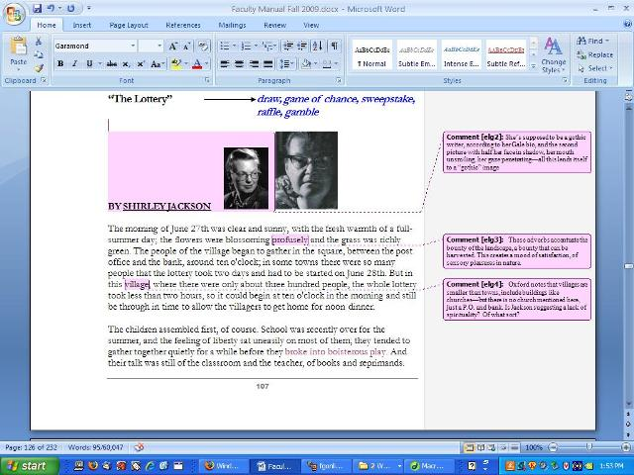

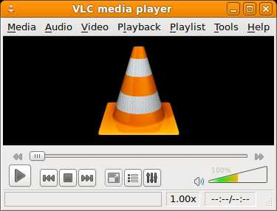

Memory Abstraction: Address Space
Address Space
Abstraction from physical memory space
Set of memory addresses that a process can use
Independently from other processes
Process, abstracts physical CPU
Address space, abstracts physical memory
File, abstracts disk
Notes:
Similarly to process, it thinks it has the entire memory (CPU)
A better solution is to invent a new abstraction for memory: the address space.
Just as the process concept creates a kind of abstract CPU to run programs, the address
space creates a kind of abstract memory for programs to live in. An address
space is the set of addresses that a process can use to address memory. Each process
has its own address space, independent of those belonging to other processes
(except in some special circumstances where processes want to share their address
spaces).
With processes, a program has the idea that it is the only one using the CPU, with address space, a program has the idea that it is the only one using the memory

Slide 13
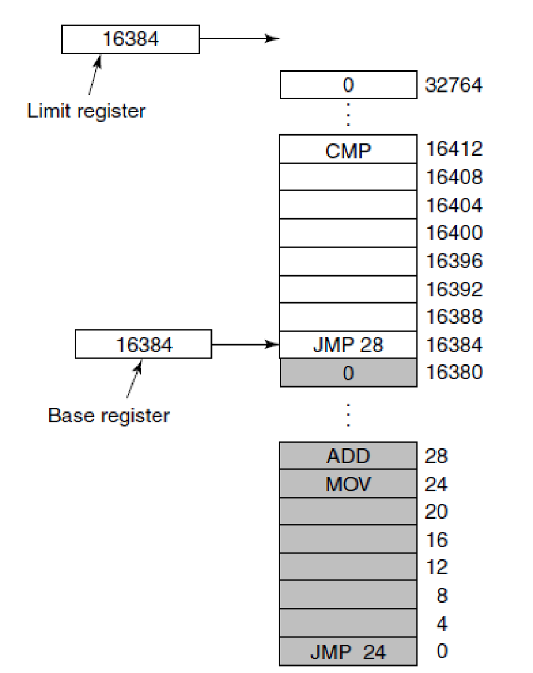
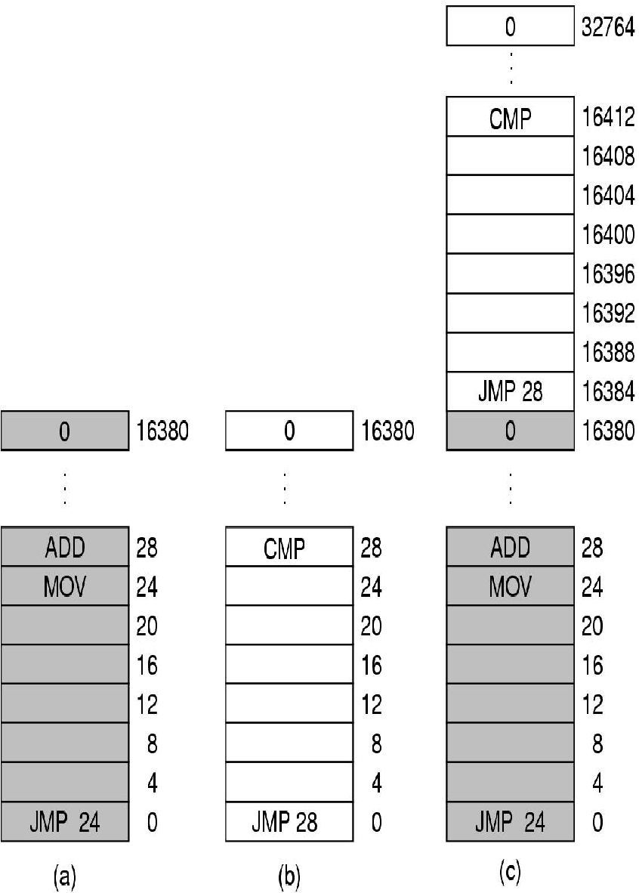
Multiple Programs: Base and Limit Registers (1)
Hardware support to ease relocation
Base register
Limit register
Program not relocatable, simple loader
Faster load time
Protection
Each process its own private address space
Base and limit registers can be used to give each process a separate address space. (MOS Figure 3-3.)
Notes:
Using base and limit registers is an easy way to give each process its own private
address space because every memory address generated automatically has the
base-register contents added to it before being sent to memory

Slide 14
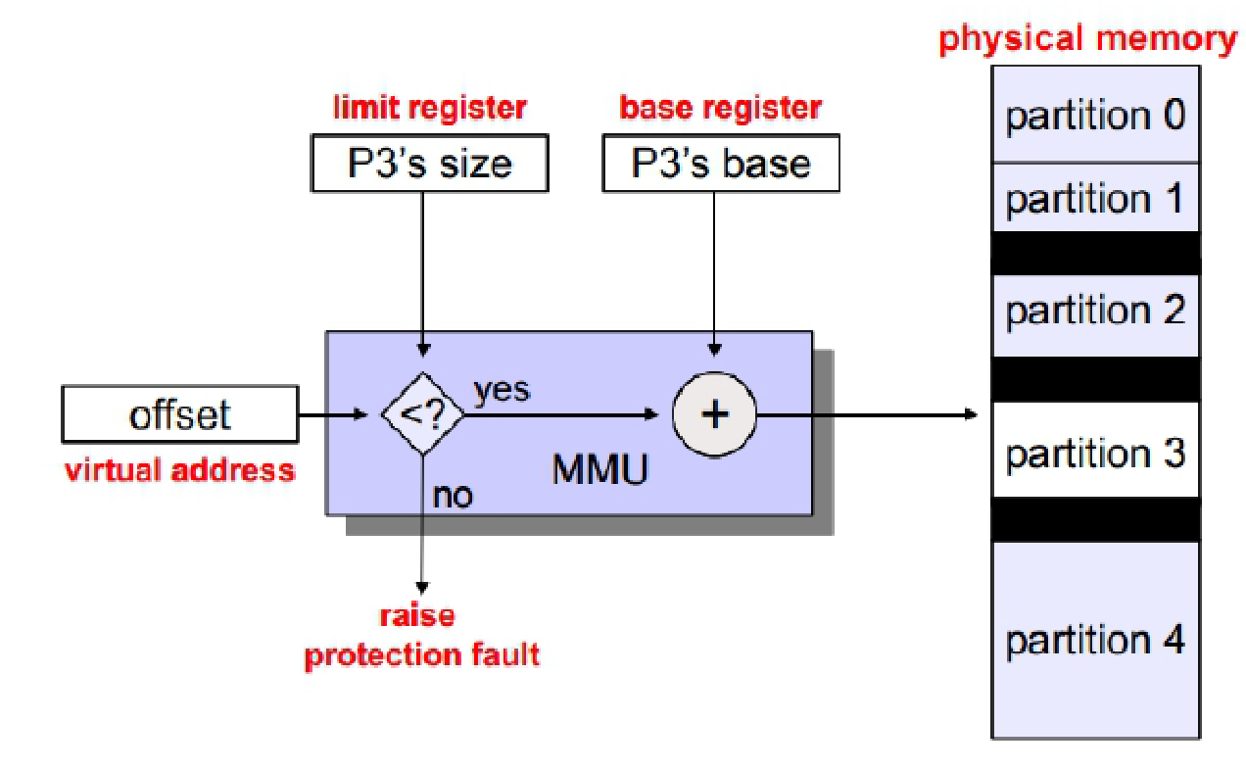
Multiple Programs: Base and Limit Registers (2)
Variable size partitions (programs)
Base register and a limit register arithmetic for performing memory access
Implementation
P3’s address

Slide 15
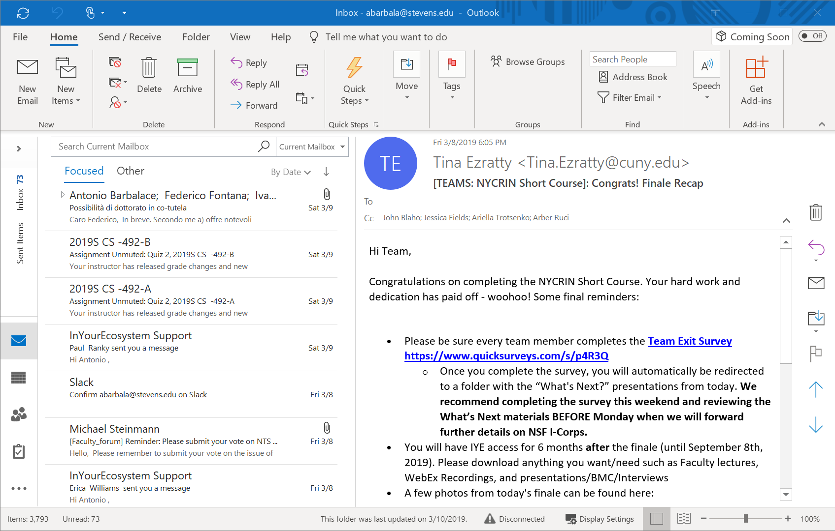
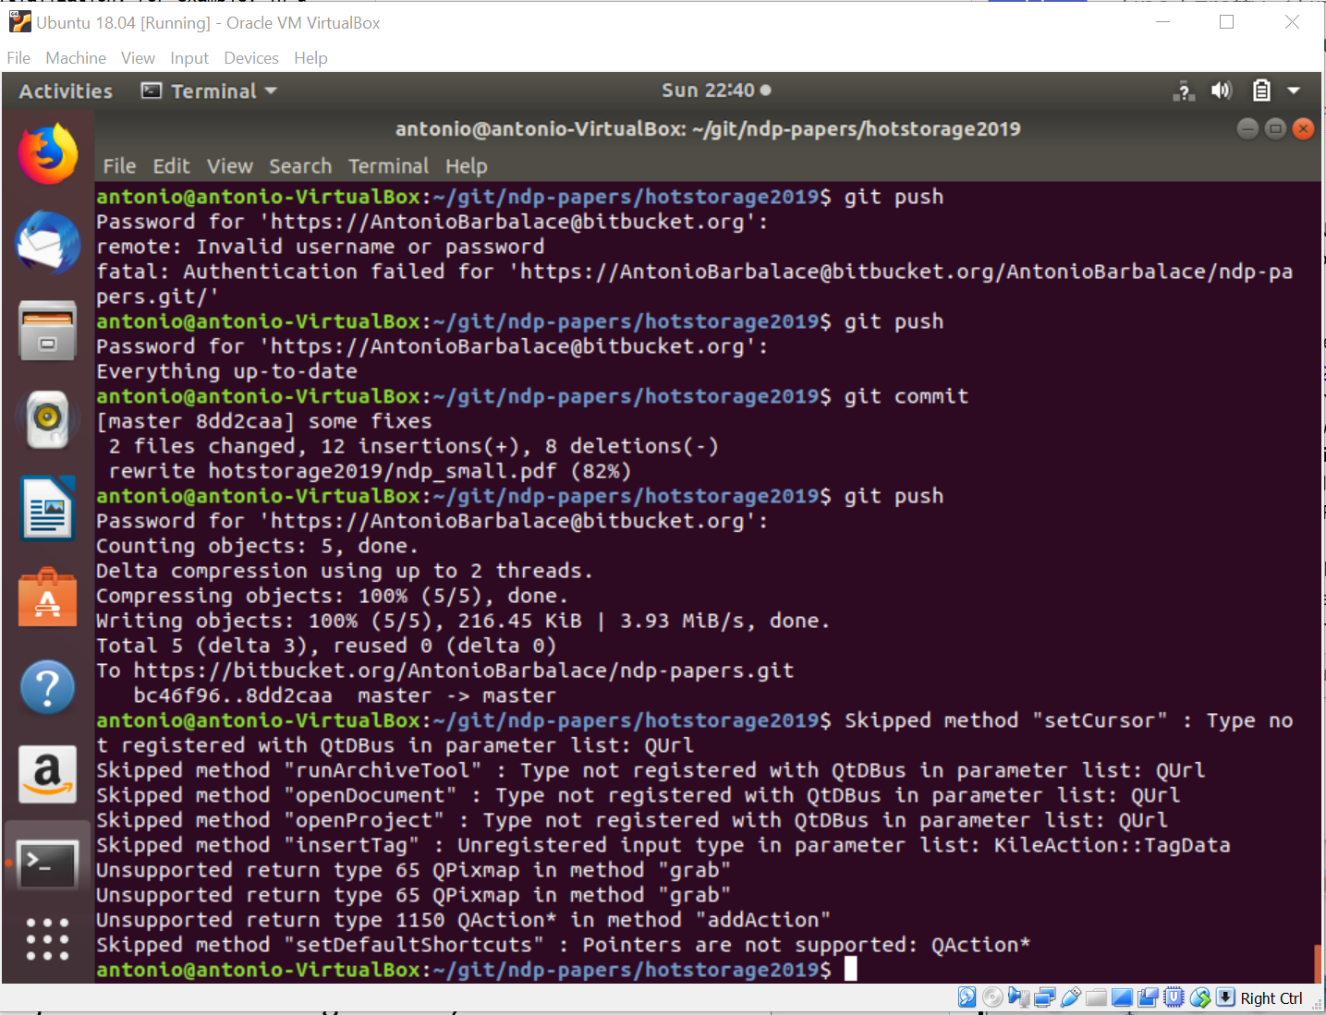
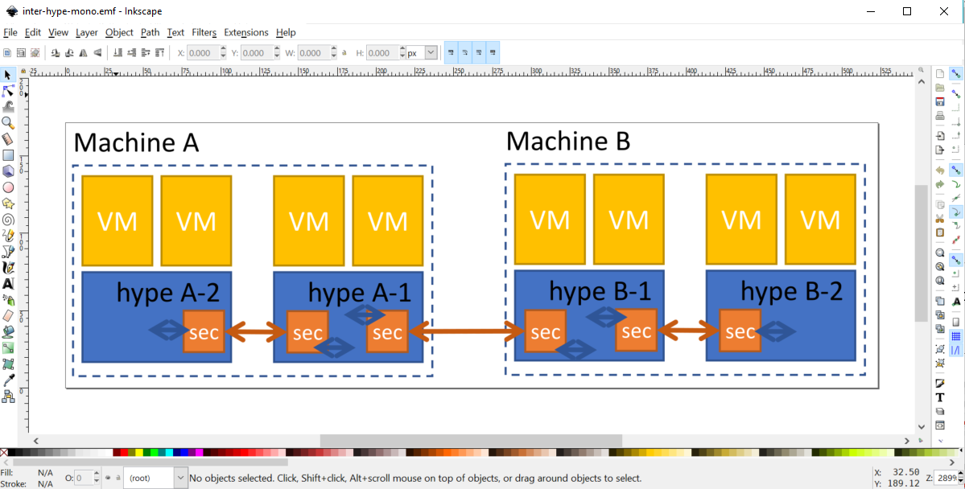
Multiple Programs: Swapping (1)
How many programs are currently executed?
Do they all fit in memory?
Notes:
If the physical memory of the computer is large enough to hold all the processes,
the schemes described so far will more or less do. But in practice, the total
amount of RAM needed by all the processes is often much more than can fit in
memory. On a typical Windows, OS X, or Linux system, something like 50–100
processes or more may be started up as soon as the computer is booted. For example,
when a Windows application is installed, it often issues commands so that
on subsequent system boots, a process will be started that does nothing except
check for updates to the application. Such a process can easily occupy 5–10 MB of
memory. Other background processes check for incoming mail, incoming network
connections, and many other things. And all this is before the first user program is
started. Serious user application programs nowadays, like Photoshop, can easily
require 500 MB just to boot and many gigabytes once they start processing data.
Consequently, keeping all processes in memory all the time requires a huge
amount of memory and cannot be done if there is insufficient memory.

Slide 16
Multiple Programs: Swapping (2)
How many programs are currently executed?
Do they all fit in memory?
Swapping
Save memory of idle processes to disk and reclaim memory
When a swapped-process needs to run, bring in its data from to disk to memory
Back to a)
Idle processes are mostly stored on disk, so they do not take up any memory when they are not running
Notes:
If the physical memory of the computer is large enough to hold all the processes,
the schemes described so far will more or less do. But in practice, the total
amount of RAM needed by all the processes is often much more than can fit in
memory. On a typical Windows, OS X, or Linux system, something like 50–100
processes or more may be started up as soon as the computer is booted. For example,
when a Windows application is installed, it often issues commands so that
on subsequent system boots, a process will be started that does nothing except
check for updates to the application. Such a process can easily occupy 5–10 MB of
memory. Other background processes check for incoming mail, incoming network
connections, and many other things. And all this is before the first user program is
started. Serious user application programs nowadays, like Photoshop, can easily
require 500 MB just to boot and many gigabytes once they start processing data.
Consequently, keeping all processes in memory all the time requires a huge
amount of memory and cannot be done if there is insufficient memory.

Slide 17
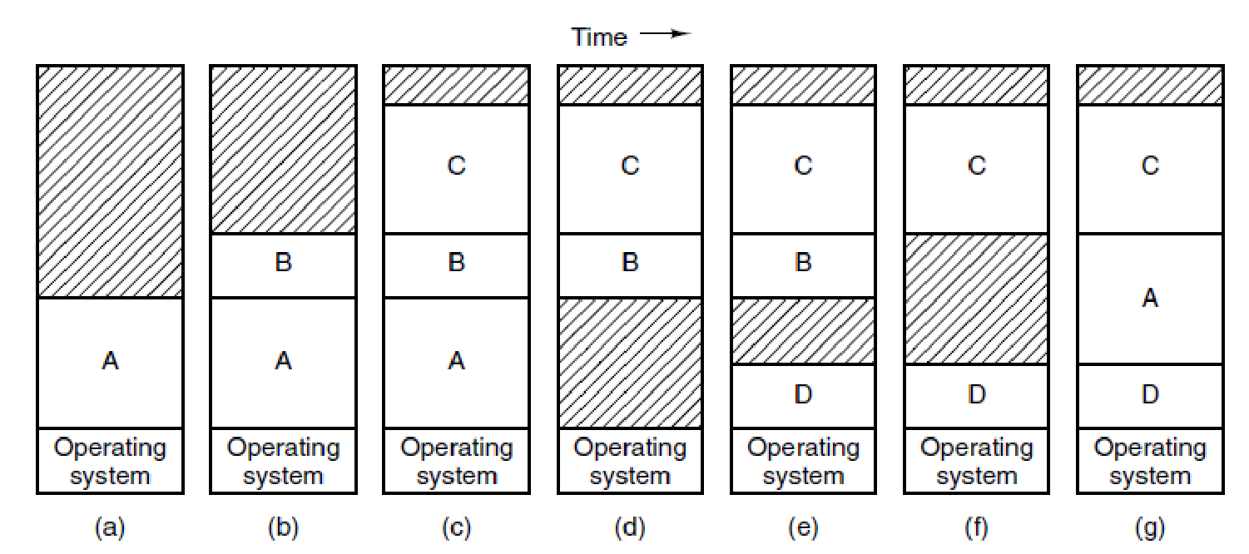
Multiple Programs: Swapping (3)
RAM
Storage
A
A
A
B
B
Memory allocation changes as processes come into memory and leave it. The shaded regions are unused memory (MOS Figure 3-4)

Slide 18
Multiple Programs: Swapping (3)
RAM
Storage
A
A
A
B
B
Memory allocation changes as processes come into memory and leave it. The shaded regions are unused memory (MOS Figure 3-4)

Slide 19
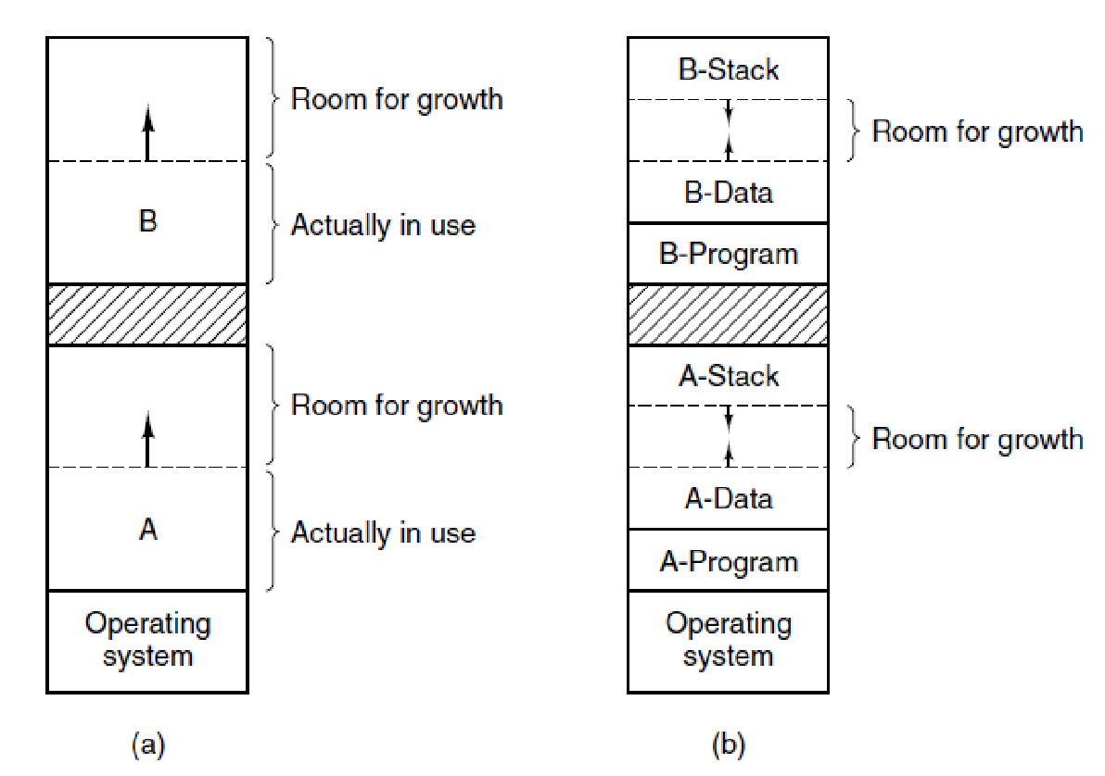
Multiple Programs: Swapping (4)
(a) Allocating space for a growing data segment. (b) Allocating space for a growing stack and a growing data segment. (MOS Figure 3-5)
Notes:
Until here the idea is that when you work with a process the process is contiguous, including base + limit

Slide 20
Multiple Programs: Memory Fragmentation
Process creation and exit, and swapping create memory holes
New processes may not fit in available memory
D
?
C
B
A
Operating System
Notes:
When swapping creates multiple holes in memory, it is possible to combine them all into one big one by moving all the processes downward as far as possible. This technique is known as memory compaction. It is usually not done because it requires a lot of CPU time. For example, on a 16-GB machine that can copy 8 bytes in 8 nsec, it would take about 16 sec to compact all of memory
If, however, processes’ data segments can grow, for example, by dynamically allocating memory from a heap, as in many programming languages, a problem occurs whenever a process tries to grow. If a hole is adjacent to the process, it can be allocated and the process allowed to grow into the hole. On the other hand, if the process is adjacent to another process, the growing process will either have to be moved to a hole in memory large enough for it, or one or more processes will have to be swapped out to create a large enough hole. If a process cannot grow in memory and the swap area on the disk is full, the process will have to suspended until some space is freed up (or it can be killed).

Slide 21
Multiple Programs: Memory Fragmentation
Process creation and exit, and swapping create memory holes
New processes may not fit in available memory
Compaction
Move all processes tightly together
Computationally expensive
What if a process needs more memory?
D
?
D
C
B
C
A
B
A
Operating System
Operating System
Notes:
When swapping creates multiple holes in memory, it is possible to combine them all into one big one by moving all the processes downward as far as possible. This technique is known as memory compaction. It is usually not done because it requires a lot of CPU time. For example, on a 16-GB machine that can copy 8 bytes in 8 nsec, it would take about 16 sec to compact all of memory
If, however, processes’ data segments can grow, for example, by dynamically allocating memory from a heap, as in many programming languages, a problem occurs whenever a process tries to grow. If a hole is adjacent to the process, it can be allocated and the process allowed to grow into the hole. On the other hand, if the process is adjacent to another process, the growing process will either have to be moved to a hole in memory large enough for it, or one or more processes will have to be swapped out to create a large enough hole. If a process cannot grow in memory and the swap area on the disk is full, the process will have to suspended until some space is freed up (or it can be killed).

Slide 22
Process Growth
Problem: We need to allow extra room for process growth
Issues: How much extra room?
Mem usage vs. OOM (Out-Of-Memory) ris

Slide 23
Memory Management
Question: Which part of memory is allocated?
→ Divide memory in blocks (e.g. each block is 4 bytes)
● Solution 1: Bitmap keeps track of which blocks are allocated
● Solution 2: Linked list keeps track of unallocated memory

Slide 24
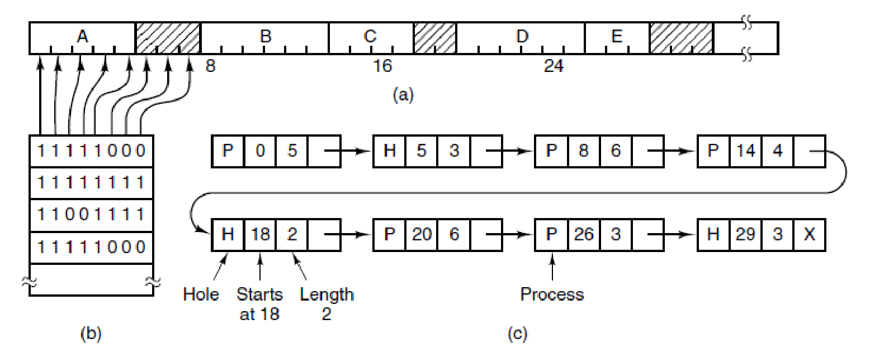
Memory Management with Bitmap
Allocation units, as small as words and as large as kB
Each allocation unit has a bit in the bitmap
1 if occupied, 0 if free
Figure 3-6. (a) A part of memory with five processes and three holes. The tick marks show the memory allocation units. The shaded regions (0 in the bitmap) are free. (b) The corresponding bitmap.
The main problem with this data structure is the search time

Slide 25
Memory Management with Linked List (1)
Node P contains a process
Node H is a hole (free)
Each node has a start and an end address
Figure 3-6. (a) A part of memory with five processes and three holes. The tick
marks show the memory allocation units. The shaded regions are free. (c) The same information as a list.

Slide 26
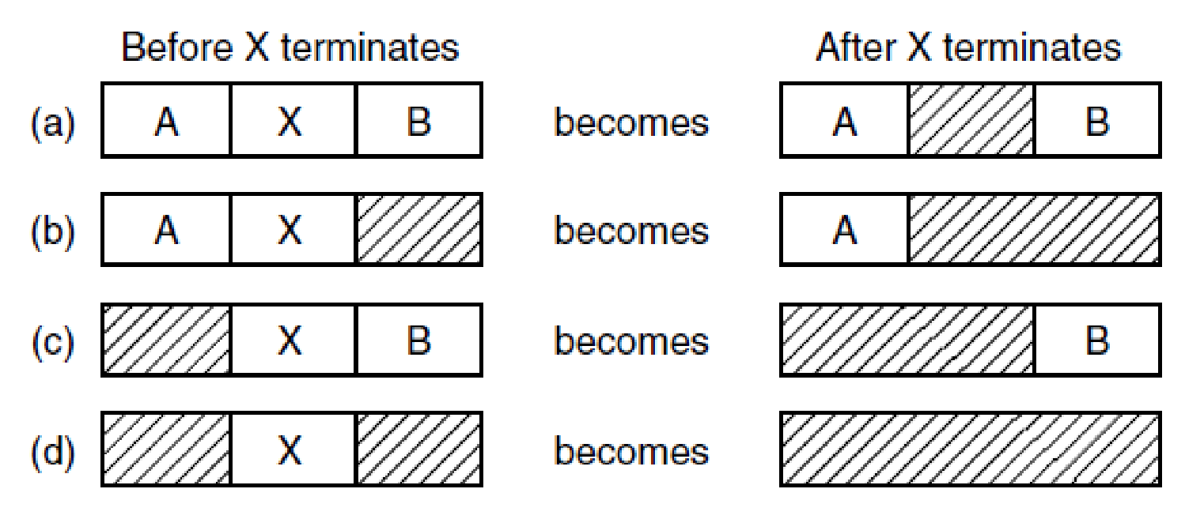
Memory Management with Linked List (2)
Being sorted list when a process exits is easy to merge back nodes
Often double-linked list
Four neighbor combinations for the terminating process, X. (MOS Figure 3-5)

Slide 27

Memory Management Algorithms
First fit: take first fitting hole (MINIX 3)
Simplest option
Next fit: Take next fitting hole
Slower than first fit in practice
Best fit: Take best fitting hole
Prone to fragmentation
Worst fit: Take worst fitting hole
Poor performance in practice
Quick fit: Keep holes of different sizes
Poor coalescing performance

Slide 28

Large Programs: Overlays (1)
How to deal with a program that is bigger than the available physical memory?
Program
size
RAM
size
>
0x00
0x00
Notes:
https://medium.com/mozilla-tech/the-search-for-the-goldilocks-browser-and-why-firefox-may-be-just-right-for-you-1f520506aa35

Slide 29
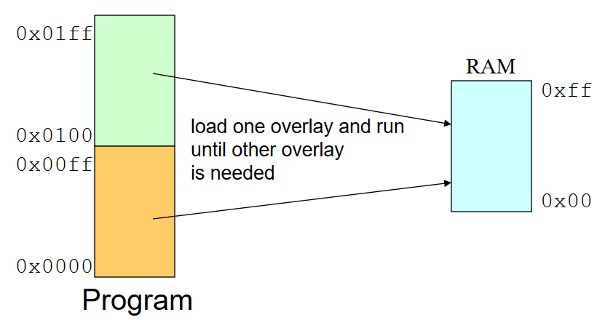
Large Programs: Overlays (2)
How to deal with a program that is bigger than the available physical memory?
Overlays
Only load part of the program
Programmer breaks address space into pieces that fit into physical memory
Pieces called overlays, are loaded and unloaded by the program (no hardware, no OS)
Notes:
https://slideplayer.com/slide/3333839/
https://codingrelic.geekhold.com/2011/01/overlays-not-yet-extinct.html
http://infocenter.arm.com/help/index.jsp?topic=/com.arm.doc.faqs/ka4234.html
https://access.redhat.com/documentation/en-US/Red_Hat_Enterprise_Linux/4/html/Debugging_with_gdb/overlay-sample-program.html
https://opensource.apple.com/source/gdb/gdb-952/src/gdb/testsuite/gdb.base/ovlymgr.c.auto.html
https://en.wikipedia.org/wiki/Overlay_(programming)
https://sourceware.org/gdb/onlinedocs/gdb/How-Overlays-Work.html

Slide 30
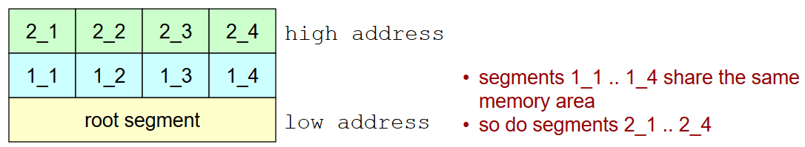
Large Programs: Overlays (3)
Overlay manager (part of the program)
Loads an overlay segment when it is not in RAM
Eventually unloads a segment previously in RAM
Overlays Mechanism
One root segment (always in RAM)
Includes overlay manager
2 or more memory partitions
Within each partition any number of overlay segments
Only 1 overlay segment can be in a partition at a given time
Notes:
Static, statically assign an overlay to partition
Dynamic overlay
Include re-location information with each overlay segment (each segment can be placed at any overlay partition)
Have overlay manger allocate memory for an overlay segment when it is first loaded
Load and unload overlay segments by explicit calls to overlay manager
Each overlay segment is given its own name linker links each as if it were in its own paritition

Slide 31
Large Programs: Overlays (4)
Issue(s)
Implemented in the program itself
High complexity for the developer
Not general management of resources (no OS involved)
Reduced memory exploitation
Management overhead

Slide 32
How To Run Programs on Physical Memory
Base+Limit registers
Protection
Relocation
Swapping
Fitting multiple programs
Compaction/memory management
Fragmentation – very expensive
Overlay manager
Application larger than memory – very expensive, difficult to program, reduced resource exploitation, no operating system involvement

